Slide 1
Edge/Fog Computing

Slide 2
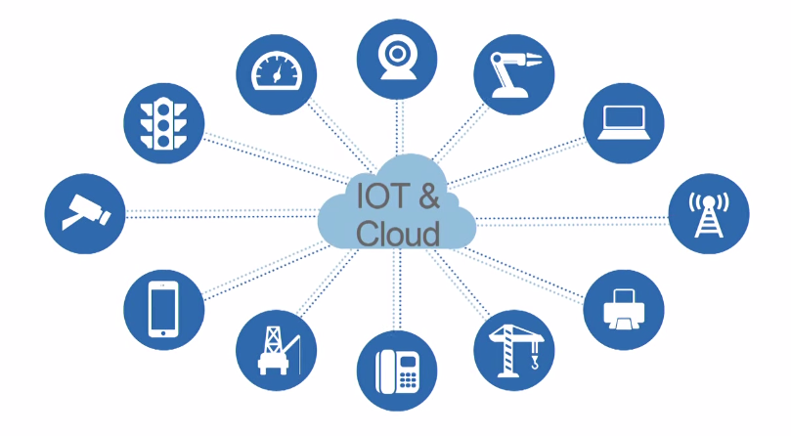
Cloud Computing
Many years ago, the IoT started its communication with the centralized server in the cloud like this, as shown in the figure.
Basically, it is making use of Centralized servers hosted in the core internet rather than using a local sever or personal system for huge processing/computation or storage of data.
In the present times almost all the organizations uses cloud.

Slide 3
Discussion
Need for fog computing
Why can’t do all in cloud?
Why can’t do all in end systems?

Slide 4
Need for fog computing
Why can’t do all in cloud?
Cloud computing frees the enterprise and the end user from many details.
This becomes a problem for latency-sensitive applications.
Why can’t do all in end systems?
Physical constraints: Energy, space, etc.,
Limited computing and storage capacity.
Notes:
Iot is generating unprecedented volume and variety of data, by the time it makes to the cloud for analysis, the opportunity to act upon the data might be gone.
Also, Loads of useless data are been pushed to the cloud. Fog filters out and sends useful data to clouds.
Anyway, these are a few examples, we see key attributes of fog computing later in the slides.
End systems might be sensors, actuators could be stolen.

Slide 5
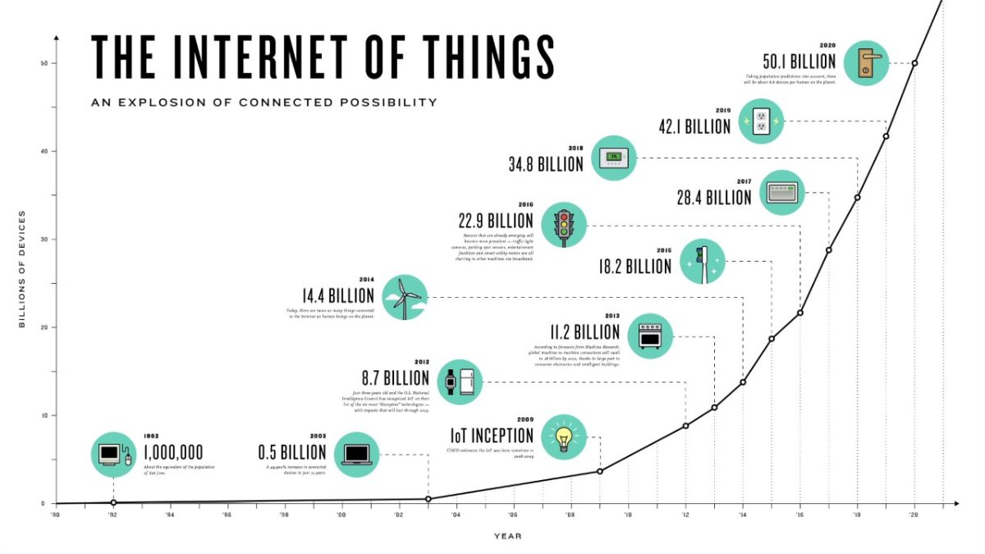
Number of end devices that are connected to internet rose above 50+ billion in 2020.
Cloud computing architectures won’t be able to handle the demand of the Internet of things. So only cloud is not the optimal solution to handle this massive explosion.
Fog is needed in between to optimize – need for an intermediary between cloud and end systems.

Slide 6
Why Off-premise Cloud is not suitable for certain IoT applications?
Cloud is centralized, federated, consolidated, shared, automated, and programmable Infrastructure
Latency and Response time is often a critical part, especially when you deal with human life or emergency procedure.
Bandwidth Cost and Capacity is very often underestimated. If you want to use many smart devices requiring each one to communicate with cloud, then you can quickly reach huge bandwidth requirements at a gateway level.
Security and Privacy - transmitting device data over any open and public network is risky
Power consumption - Cloud computing is energy-hungry and that it is a concern for a low-carbon economy.
Data amount – In a traditional cloud approach, huge amount of untreated data are pumped blindly into the cloud. This vision is really not the best efficient and it is much wiser to pre-treat data at a local level and to limit the cloud processes.
Offline usages versus only-online usages – Pure cloud services do not allow offline usages. It is a major shortcoming since smart cities and industry applications require a dual offline/online paradigm.

Slide 7
Why some IoT applications have to be real-time and at Edge?
Volume and Velocity – ingesting, processing and storing such huge amounts of data which is gathered in real-time.
Security – devices can be located in sensitive environments, control vital systems or send private data. With the number of devices and the fact they are not humans who can simply type a password, new paradigms and strict authentication and access control must be implemented.
Bandwidth – if devices constantly send the sensor and video data, it will hog the internet and cost a fortune. Therefore, edge approaches must be deployed to achieve scale and lower response time.
Real-time Data Capture, Storage, Processing, Analytics, Knowledge Discovery, Decision-making and Actuation
Less Latency and Faster Response
Combining real-time data with historical state – there are analytics solutions which handle batch quite well and some tools that can process streams without historical context. It is quite challenging to analyze streams and combine them with historical data in real-time.

Slide 8
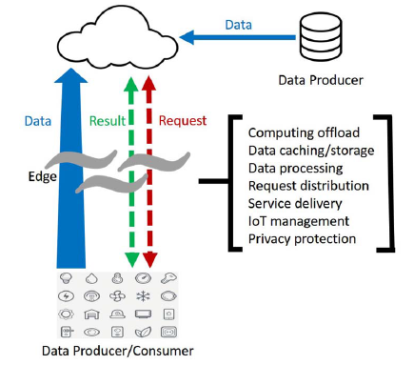
What is Edge/Fog computing?
We define “edge” as any computing and network resources along the path between data sources and cloud data centers.
Edge computing is interchangeable with fog computing.
Edge Computing
Edge computing is a method of optimizing cloud computing systems by performing data processing at the edge of the network, near the source of the data. -- Wikipedia: Edge Computing
Reduce data transfer
Low latency
Local feedback loop
Privacy
Security
Notes:
a smart phone is the edge between body things and cloud, a gateway in a smart home is the edge between home things and cloud, a micro data
center and a cloudlet is the edge between a mobile device and cloud

Slide 9
Fog nodes can be deployed anywhere with a network connection: on a factory floor, on top of a power pole, alongside a railway track, in a vehicle, or on an oil rig. Any device with computing, storage, and network connectivity can be a fog node. Examples include industrial controllers, switches, routers, embedded servers, and video surveillance cameras.

Slide 10
The Device Categories

Slide 11
Edge and Cloud
Cloud | Edge
Off site | On site
Limited control | Full control
Virtually unlimited resources | Limited resources
Easy scaling | No or limited scaling
High latency | Low Latency
Limited privacy | Full privacy

Slide 12
The Industry Use Cases of Fog/Edge Computing
Manufacturing - From creating semiconductors to the assembly of giant industrial machines, edge intelligence enhances manufacturing yields and efficiency using real-time monitoring and diagnostics, machine learning, and operations optimization. The immediacy of edge intelligence enables automated feedback loops in the manufacturing process as well as predictive maintenance for maximizing the uptime and lifespan of equipment and assembly lines.
Oil and gas extraction are high-stakes technology-driven operations that depend on real-time onsite intelligence to provide proactive monitoring and protection against equipment failure and environmental damage. Because these operations are very remote and lack reliable high speed access to centralized data centers, edge intelligence provides onsite delivery of advanced analytics and enables real-time responses required to ensure maximum production and safety.
Mining faces extreme environmental conditions in very remote locations with little or no access to the Internet. As a result mining operations are relying more and more on edge intelligence for real-time, onsite monitoring and diagnostics, alarm management, and predictive maintenance to maximize safety, operational efficiency, and to minimize costs and downtime.

Slide 13
The Industry Use Cases of Fog/Edge Computing
Transportation - As part of the rise in the Industrial Internet, trains and tracks, buses, aircraft, and ships are being equipped with a new generation of instruments and sensors generating petabytes of data that will require additional intelligence for analysis and real-time response. Edge intelligence can process this data locally to enable real-time asset monitoring and management to minimize operational risk and downtime. It can also be used to monitor and control engine idle times to reduce emissions, conserve fuel and maximize profits.
Power and Water - The unexpected failure of an electrical power plant can create substantial disruption to the downstream power grid. The same holds true when water distribution equipment and pumps fail without warning. To avoid this, edge intelligence enables the proactive benefits of predictive maintenance and real-time responsiveness. It also enables ingestion and analysis of sensor data closer to the source rather than the cloud to reduce latency and bandwidth costs.
Renewable Energy - New solar, wind, and hydro are very promising sources of clean energy. However constantly changing weather conditions present major challenges for both predicting and delivering a reliable supply of electricity to the power grid. Edge intelligence enables real-time adjustments to maximize power generation as well as advanced analytics for accurate energy forecasting and delivery.

Slide 14
The Industry Use Cases of Fog/Edge Computing
Healthcare - In the healthcare industry, new diagnostic equipment, patient monitoring tools, and operational technologies are delivering unprecedented levels of patient care but also huge amounts highly sensitive patient data. By processing and analyzing more data at the source, medical facilities can optimize supply chain operations and enhance patient services and privacy at a much lower cost.
Retail - To compete with online shopping, retailers must lower costs while creating enhanced customer experiences and levels of service that online stores cannot provide. Edge intelligence can enrich the user experience by delivering real-time channel personalization and supply chain optimization. It also enables newer technologies such as facial recognition to deliver even higher levels of personalization and security.
Smart Buildings - Among the many benefits of smart building technology are lower energy consumption, better security, increased occupant comfort and safety, and better utilization of building assets and services. Rather than sending massive amounts of building data to the cloud for analysis, smart buildings can use edge intelligence for more responsive automation while reducing bandwidth costs and latency.
Drones/Flying Robots/Unmanned Aerial Vehicles (UAVs) for surveillance and instant delivery – Edge computing facilitates the monitoring, measurement and management of drones.

Slide 15
The Industry Use Cases of Fog/Edge Computing
Connected Vehicles - Connected vehicle technology adds an entirely new dimension to transportation by extending vehicle operations and controls beyond the driver to include external networks and systems. Edge intelligence and fog computing will enable distributed roadside services such as traffic regulation, vehicle speed management, toll collection, parking assistance, and more.
In automobile manufacturing, real-time analytics can be performed on sensor streams from the engine and other parts, alerting the driver to potential imminent failure or to the need for preventive maintenance. Such information can also be transmitted to the cloud or EDW for integration into a database maintained by the vehicle manufacturer. Fine-grain analysis of such anomaly data might reveal vehicle model-specific defects that can be corrected in a timely manner.
In the aerospace industry, the sensors in various parts of the airplane generate huge amount of data on the order of 1 terabyte per 24 hours. Intelligent devices (compared to connected devices) would be of great, and sometimes lifesaving, help as immediate proactive actions based on sensor readings could prevent crucial failures.
The industrial Internet is going to transform the industry by making industrial machines more intelligent and enabling services using real-time data coming from sensors and machines. The intelligent devices will be able to take actions (to optimize processes, improve efficiencies, reduce costs, etc.) based on insights generated from real-time data and analytics.
Smart Cities - Integrating data from a diverse collection of municipal systems (e.g. Street lighting, traffic information, parking, public safety, etc.) for interactive management and community access is a common vision for smart city initiatives. However the sheer amount of data generated requires too much bandwidth and processing for cloud-based systems. Edge intelligence provides a more effective solution that distributes data processing and analytics to the edges where sensors and data sources are located.

Slide 16
Key attributes of Edge computing
The use cases that were discussed brings up a number of attributes that differentiate Fog computing platform from the Cloud.
Applications that require very low and predictable latency.
Geo-distributed applications
Fast mobile applications
Large-scale distributed control systems
IoT also brings Big Data with a twist: rather than high volume, the number of data sources distributed geographically
Notes:
These attributes do not apply uniformly to every use case.

Slide 17
Discussion
Do you think edge/fog computing can completely replace the cloud? Why or why not?
Please go to
PollEv.com/cisgvsu429

Slide 18
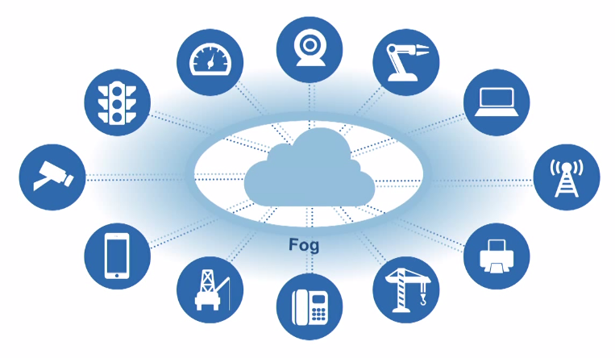
Fog Computing
Fog computing is making use of decentralized servers in between network core and network edge for data processing and to serve the immediate requirements of the end systems.
Does this replace the cloud?
No, Fog computing is non-trivial extension of Cloud computing paradigm to the edge of the network. The cloud has better computing and storage power than the edge servers. Many computing or storage intensive applications should still run in the cloud.

